Slide 1

Lecture 6 Array

Slide 2
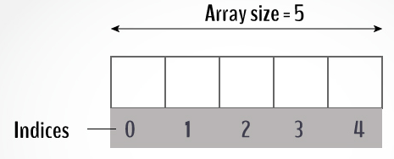
Array
A data structure, the array,
Stores a fixed-size
Sequential collection of elements
Of the same type
A sequence of values that are all of the same type.
If we have n values, we think of them as being numbered from 0 to n−1.

Slide 3
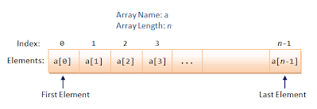
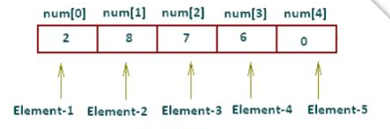
Representation of array

Slide 4
Creating Array Variables
dataType[] arrayName = new dataType[arraySize];
double[] myList = new double[5];
Initializing an array
dataType[] arrayName = {value0, value1, ..., value k};
double[] myList = {10,20,30,40,50};
10 | 20 | 30 | 40 | 50
myList[0] | myList[1] | myList[2] | myList[3] | myList[4]

Slide 5
Examples
float[] numbers = {10.5f , 6.7f , 8.9f };
String[] SUITS = { "Clubs", "Diamonds", "Hearts", "Spades" }
int[] numbers = {3 ,5 ,6 ,8};
char[] letters = {‘a’ , ‘s’ ,’d’ ,’f’, ‘g’, ‘h’, ‘j’, ‘k’, ‘l’};

Slide 6
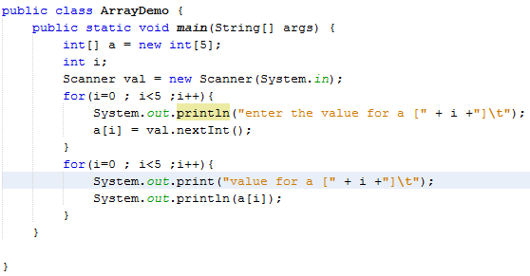
Processing Arrays

Slide 7
Array Class
java.util.Arrays
class contains various static methods for sorting and searching arrays, comparing arrays, and filling array elements.

Slide 8
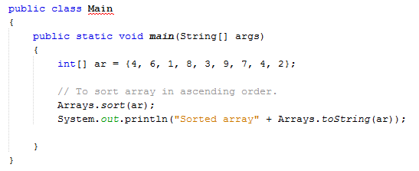
public static void sort(int[] a)
Sorts the specified array into ascending numerical order.

Slide 9
public static int binarySearch(int[] a, int key)
Returns an int value for the index of the specified key in the specified array.
Returns a negative number if the specified key is not found in the array.
For this method to work properly, the array must first be sorted by the sort method.

Slide 10
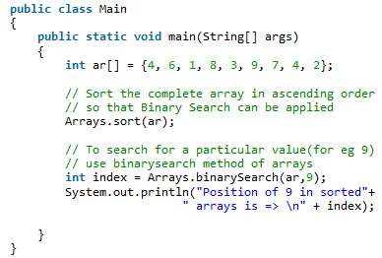

Example

Slide 11
Exercise
Set up an array to hold the following values, and in this order: 23, 6, 47, 35, 2, 14. Write a program to get the sum and average of all 6 numbers.
Using the above values, have your program print out the highest and lowest number in the array.

Slide 12
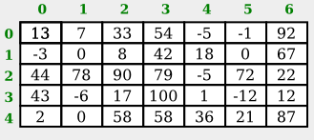
Multi-Dimensional Arrays in Java
In a two-dimensional, or "2D," array, the elements can be arranged in rows and columns.
for example, is a 2D array of int that has five rows and seven columns:

Slide 13

int[][] A = new int[3][4];
Assigning values

Slide 14
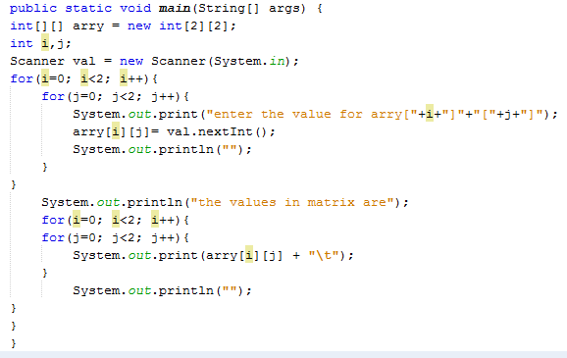
Example

Slide 15
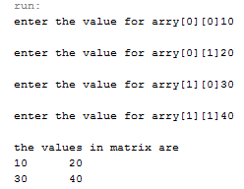
Output

Slide 16
Exercise
1. Perform addition of two 2D matrix.
Ask user to enter the values in matrix.
Equation for addition of two matrix is
C[i][j] = a[i][j] + b[i][j];
e.g. a[2][2] = { {10,20},{30,40}}
b[2][2]= { {50,60}, {70,80}}
C[2][2] = { {60, 80} , {100,120}}

Slide 17
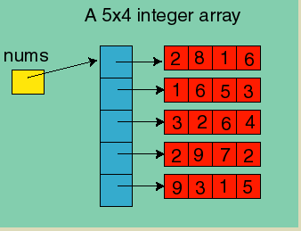
A 2-D Array is really an Array of Arrays

Slide 18
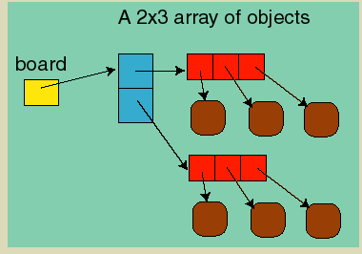
Internally, Java stores 2 dimensional arrays as an array of arrays:

Slide 19
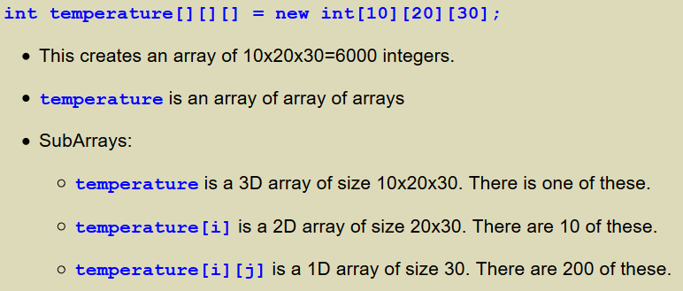
Higher Dimensional Arrays
One can create arrays of higher dimension than 2. For example, if we were measuring the temperature in a rectangular volume.

Slide 20
Array as an parameter to method
We can pass an array as a parameter to a method or a constructor.
A method that receives an array as a parameter can permanently change an element of the array

Slide 21
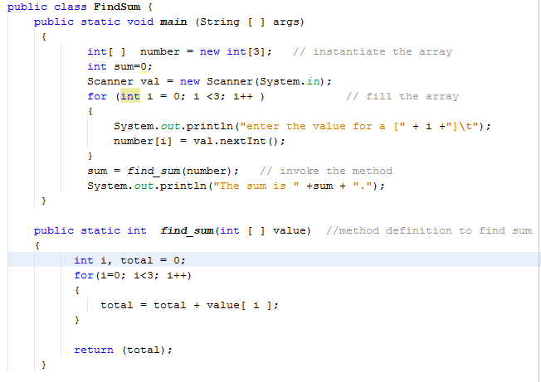
Fill an array with 10 integer values. Pass the array to a method that will add up the values and return the sum

Slide 22
Arrays of objects
We used arrays to store primitive types such as integers and characters
Array can also store references to objects as elements
EX: an array contain objects and each of this objects consist of several variable and methods that uses them

Slide 23
class Student
{ int marks;
}
An array of objects is created just like an array of primitive type data items
Student[] studentArray = new Student[7];
The above statement creates the array which can hold references to seven Student objects. It doesnot creates objects. They have to be created .

Slide 24
the following statement throws a NullPointerException
studentArray[0].marks = 100;
Student objects needs to be created
for ( int i=0; i<7; i++)
{ studentArray[i] = new Student(); }

Slide 25
Variable length array : - ArrayList
Standard Java arrays are of a fixed length. After arrays are created, they cannot grow or shrink, which means that you must know in advance how many elements an array will hold.
ArrayList supports dynamic arrays that can grow as needed.
Array lists are created with an initial size. When this size is exceeded, the collection is automatically enlarged. When objects are removed, the array may be shrunk.

Slide 26
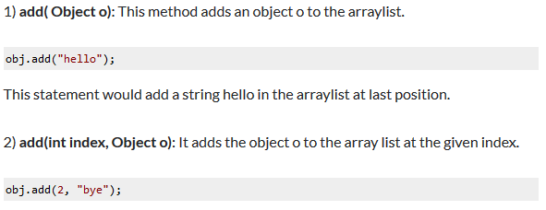
Methods of ArrayList class

Slide 27
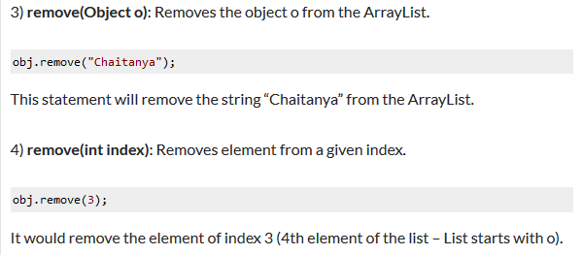
Methods of ArrayList class

Slide 28
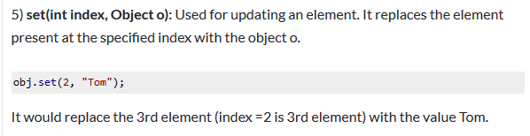
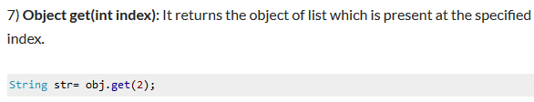
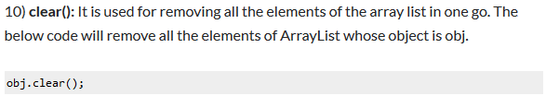
Methods of ArrayList class

